Slide 1





RUN_DOWN
Software Project Lab-I
SWE 4304
October 25, 2023
01

Slide 2

Table Of Content
List of team members
Title of the project.
Project Overview
Tools and Technology
Features
Features Achieved
Diagram
Remaining Tasks & future Scope
Current Timeline
02

Slide 3

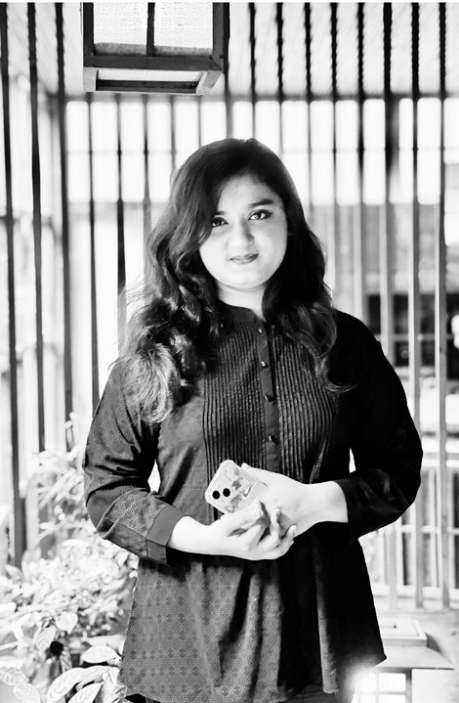
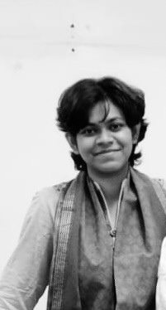

Our team
Nabila Islam
Namisa Najah Raisa
Faiza Maliat
210042111
210042112
210042163
03

Slide 4



Project Title
Run_Down
- A sports score tracking application
04

Slide 5

Project Overview
Our project aims to develop a comprehensive Sports Score Tracking application.
Primarily our motive is to develop a cricket sports score tracking application.
05

Slide 6
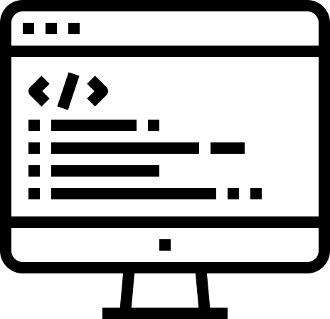




Programming Language:
C#
Data Storage:
Text File
User Interface:
Tools and Technology
Console-based user interface
Version Control:
GitHub
IDE:
Visual Studio
06

Slide 7
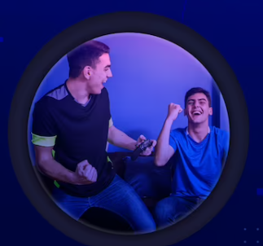
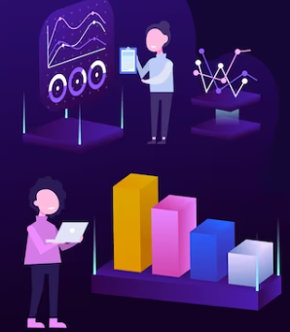
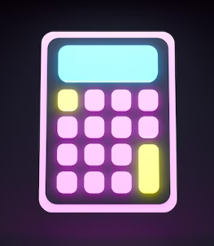
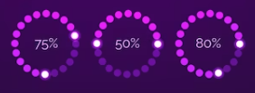
Features
Score Tracking
Simple Navigation
Run Rate Calculation
Prediction
Team and Player Management
Multiple Functionalities
Run Analysis
Package Development
08

Slide 8
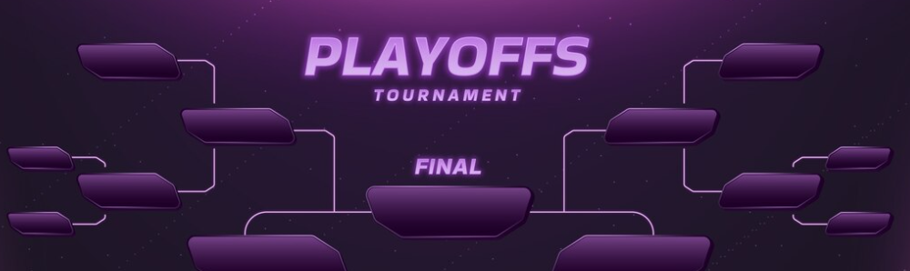
Current Status
Toss generate
Score Tracking
Simple Navigation
Features Achieved
Run Rate Calculation
Prediction
Multiple Functionalities
09

Slide 9
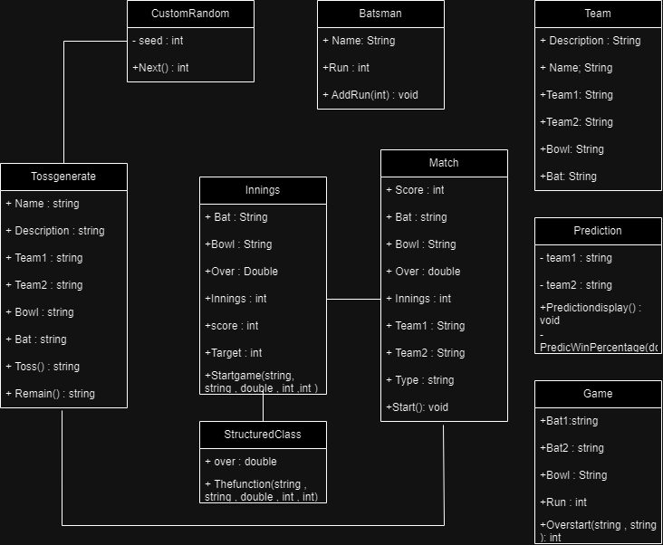
UML
Diagram

Slide 10
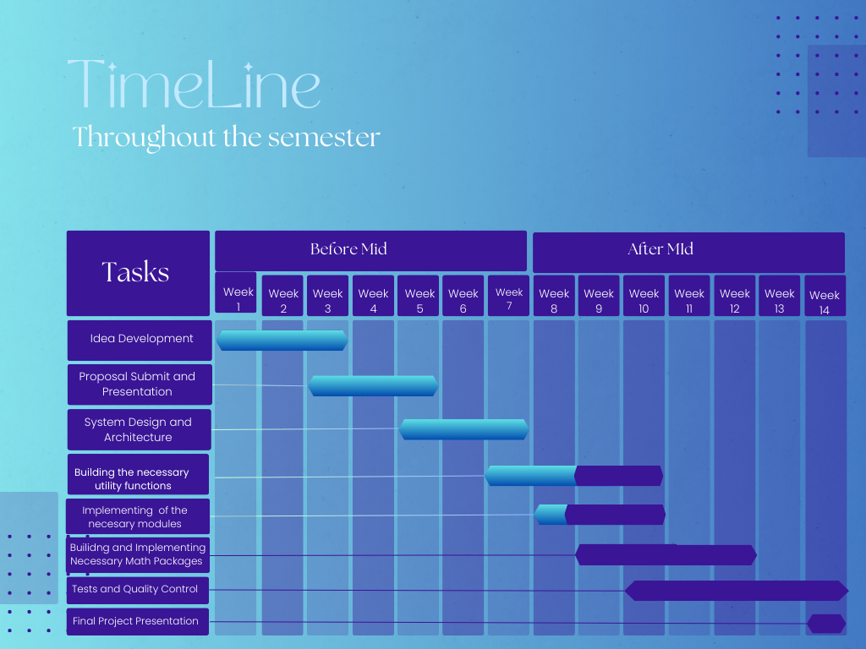


Current Timeline
Completed
Remaining
12

Slide 11

Remaining tasks
Unit Tests and quality control
Game History & Match Summary
Implementing math packages if necessary
Fully functional winning prediction system
Applying all possible concepts of the object oriented concepts
Future Scope
Run Rate Graph
Comparison Graph
Wickets Fall Graph
10
Scoreboard Customization

Slide 12
THANK YOU
13

